Slide 1
General Meeting #6
MOVING FURTHER INTO FINANCE
October 13th, 2021

Slide 2
Before Breakout Meetings
SECTION I
QUICK REMINDERS

Slide 3
Reminders for this Coming Week
Reminders
Signup for Slack and turn on reminders
Signup on the USIT portal and pay dues
USIT Retreat this Weekend Make sure that you register!
Dates
QMI General Meeting #7 (10/18/21)
Homework #2 Due Before Meeting #8 (10/20/21)
USIT Retreat *very very encouraged* (this weekend)

Slide 4
Introduction to Statistical Measures
S E C T I O N I I
LAVANYA

Slide 5
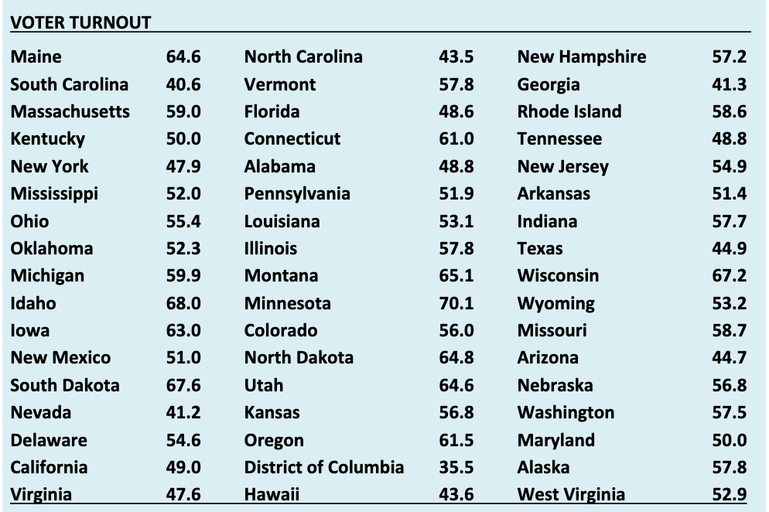
Basics
WHY DO WE NEED STATISTICS?
Big Data: new currency of the world.
Descriptive Statistics help us take control of this data and use it effectively.
Distribution of a Variable
Class intervals, relative frequencies
Notes:
Individuals are barraged with numerical information every day, and they form opinions and
take actions based on those data. Businesses and governments make decisions based on data.
Researchers gather and analyze data in order to in order to improve our understanding of the world.
graph: age of

Slide 6
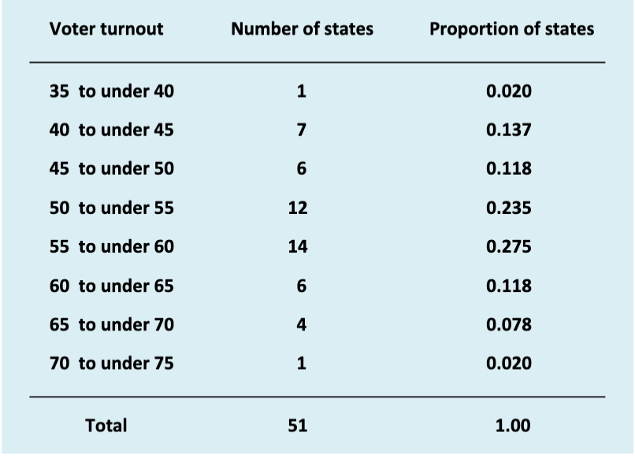
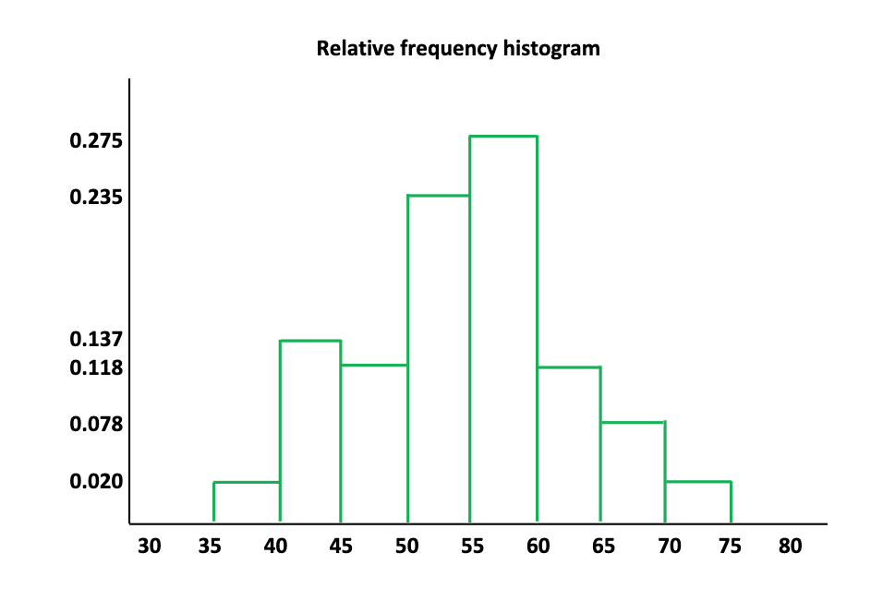

Slide 7
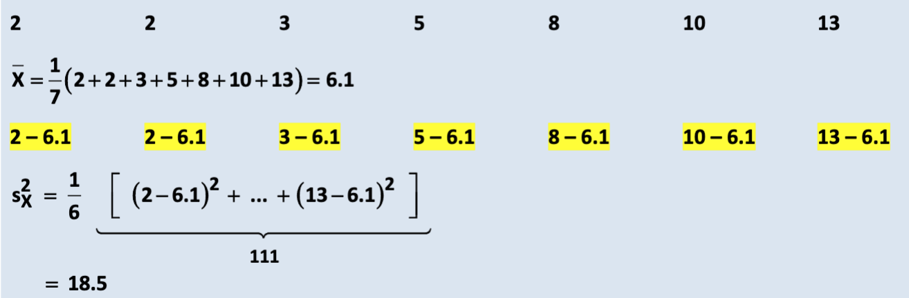
Univariate vs Bivariate
Univariate Statistics: the distribution of one variable
Measure of central tendency
Mode
Mean
Median
Measure of dispersion
Range
Interquartile range (IQR)
Variance and Standard Deviation
2 2 3 5 8 10 15 22

Slide 8
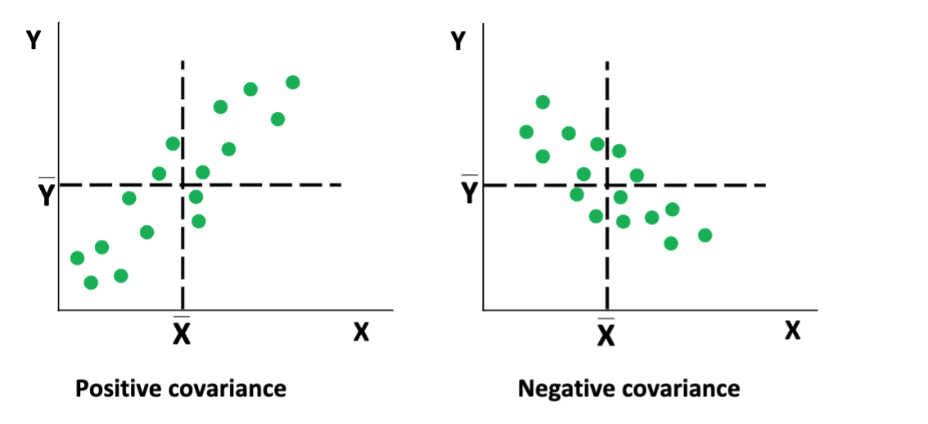
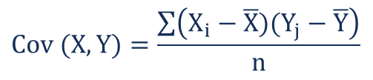
Univariate vs Bivariate
Bivariate Statistics: the distribution of two variables
Covariance, Correlation
Covariance: direction of the linear relationship between two variables

Slide 9
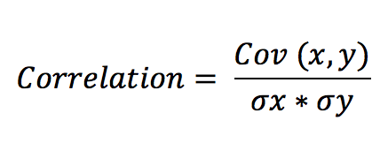
Correlation
PEARSON VS SPEARMAN
Pearson Correlation: linear relationship between two variables, strength
If cor = -1: negative relationship
If cor = 0: no relationship
If cor = 1: positive relationship

Slide 10
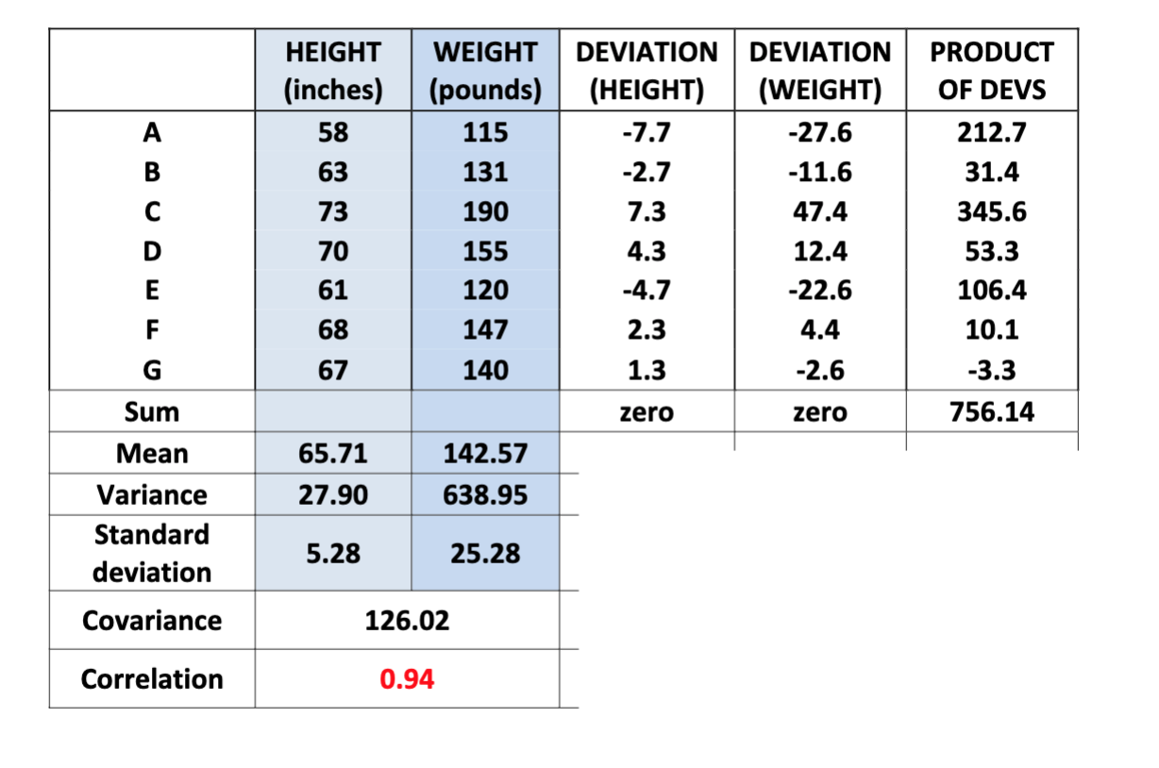
Summary

Slide 11
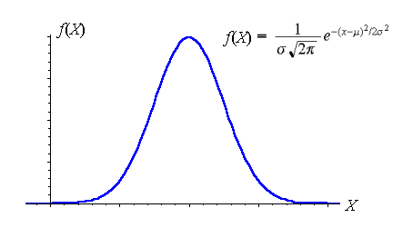
Continuous Distribution
NORMAL DISTRIBUTION
Most variable distributions can often be standardized/transformed to a normal distribution if they have a large enough sample size (Central Limit Theorem)
When a distribution is standardised to a normal one, we can then calculate Z-scores from it. Z-score is simply (observation - mean)/standard deviation
eg: if your test score is 85 and the mean was 70 and standard deviation 8, then your Z-score is (85-70)/8 = 15/8 = 1.875
We use this in hypothesis testing
Null, alternative hypothesis
Used in calculating p-values (probability that
values will be at the value that we are testing
for)
Way of calculating p-values
Looking at Z-score for the experiment
Looking at the p-value given for that Z-score
If the p-value is <0.05 then alternative hypothesis is true

Slide 12
Further Introduction to How to View the Market
JEREMY & ALEX

Slide 13
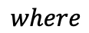
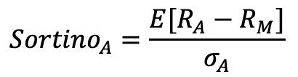
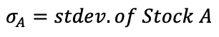
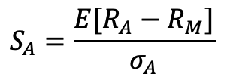
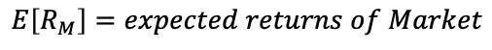
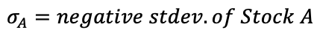
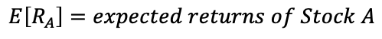
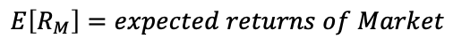
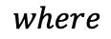
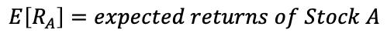
Review from Last Week
RISK-ADJUSTED RETURNS
We ended last week by discussing the Sharpe Ratio and Sortino Ratio as a way of examining risk for an investment
Sharpe Ratio measures access returns of excess of the risk-free rate over the standard deviation of returns
We noted that this was all returns standard deviation (including positive access returns)
As an alternative Sortino Ratio was proposed which examines excess returns over negative standard deviation
We also reviewed the Efficient Market Hypothesis
This is a proposed way to view the market, but we know (at least the strong form) is not possible
As a result most investors abide by the semi-strong form of EMH
$$S_{A}=\frac{E[R_{A}−R_{M}]}{σ_{A}}$$
$$where$$
$$E\left[R_{A}\right]=expected returns of Stock A$$
$$E\left[R_{M}\right]=expected returns of Market$$
$$σ_{A}=stdev. of Stock A$$
$${Sortino}_{A}=\frac{E[R_{A}−R_{M}]}{σ_{A}}$$
$$where$$
$$E\left[R_{A}\right]=expected returns of Stock A$$
$$E\left[R_{M}\right]=expected returns of Market$$
$$σ_{A}=negative stdev. of Stock A$$

Slide 14
A Random Walk
VERY GOOD BOOK: A RANDOM WALK DOWN WALL STREET
Under EMH we say that stock prices should be on a random walk meaning that at any time step (t) the price reflects all available information
At t prices reflects all information and thus it includes all future predictions of stock value
Thus, stock movements should be random if new information is truly “new”
This is why stock movements should be random, but they are not
If you look at M&A releases there is notable price gain pre-public release
We should see this in the side two graphs where there is price game before announcement
Also in-terms of earnings calls we see this price drift minutes before releases
Stock prices are also autocorrelated [more on the next slide]

Slide 15
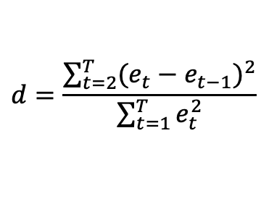
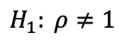
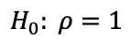
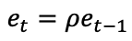
Stock Autocorrelation
STOCK RETURNS HAVE BEEN SHOWN TO BE AUTOCORRELATED
Autocorrelation: the degree of representation of similarity between a time series and the lagged same time series
If stock prices were a random walk we should not see lagged prices being a predictor of themselves
… but we do
Using the Durbin-Watson Test we can see to what degree a time series is autocorrelated
Stocks could exhibit both negative and positive autocorrelation with each other, but we would expect no autocorrelation
Tests of the S&P 500 has shown that stock returns show serial positive correlation
Can see that there is very significant autocorrelation <50 lag periods
$$d=\frac{\sum_{t=2}^{T}{{(e_{t}−e_{t−1})}^{2}}}{\sum_{t=1}^{T}{e_{t}^{2}}}$$
$$where$$
$$e_{t}=ρe_{t−1}$$
$$H_{0}: ρ=1$$
$$H_{1}: ρ≠1$$

Slide 16
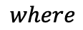
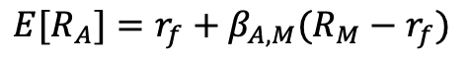
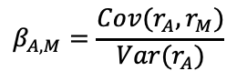
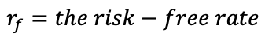
Expected Returns
EXAMINING WHAT EXPECTED RETURNS IMPLY
We say that expected returns are what an investor is “expecting” to see in the market
Under CAPM this should be uniform for all investors, but obviously this is not the case
We know that investor derive different expected returns based on their own beliefs and calculations
Using CAPM we learned that the expected returns of a stock are based entirely on beta
Beta: measure of a stocks correlation with the market (we generalize this to the S&P 500)
This does not allow for individual investor beliefs it is a purely mathematical question
We need a different way to measure expected return because CAPM is terrible
Traditional CAPM does not work because beta fails to capture nearly any information about future stock movements (Adrian & Franzoni 2008)
$${E[R}_{A}]=r_{f}+β_{A, M}(R_{M}−r_{f})$$
$$where$$
$$r_{f}=the risk−free rate$$
$$β_{A, M}=\frac{Cov(r_{A},r_{M})}{Var(r_{A})}$$

Slide 17
Black Swan Events
A CAUSE OF DIFFERENTIAL BETWEEN BLACK SWAN AND REALIZED RETURNS
Markets have returned ~7% risk-adjusted returns over the past 200 years (Benhamou et al. 2021)
Returns although typically normal, have periods of strong non-normality (Black Swan Events)
BSE hard for humans to observe because once it has happened it is included in our pricing (Taleb 2004)
We are unable to move away from our belief that the distribution of stock returns is *always* normal
Biased because there are so many indication of normality we heuristically ignore the outliers
BSE might be predictable, several indicators can be used
These suffer from hindsight bias (Taleb 2004)
New ML models have used: GBDT to learn on credit spreads, flight-to-quality, and commodity price trends (Benhamou et al. 2021)
Uses regional crashes to learn so that there are more instances of BSE

Slide 18
Semi-Strong Form Anomalies (Part 1)
THE SMALL-FIRM EFFECT & NEGLECTED-FIRM EFFECT
Original small-firm effect proposed that small firms were compensated more because they were riskier (Banz 1981)
Two subsequent justifications were provided:
Liquidity risk compensation because smaller firms are less traded (Liu 2006)
Information uncertainty compensations because smaller firms are less researched (Zhang 2006)
Evidence shows that the small-firm effect only was statistically significant in predicting returns from 1964 -1980
This means that although there might be some statistical evidence for small-firm effect it is not stable over time
Recent research on the small-firm effect has shown:
Highly seasonal, only true for domestic markets in January and not present otherwise
The original observed effect is thought to just be a representation of liquidity
It largely no longer exists in any market, this makes sense because it would have been exploited (Crain 2011)

Slide 19
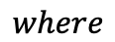
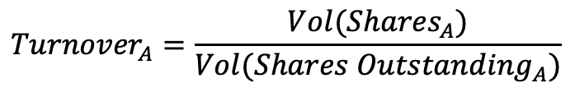
Examining Liquidity Risk
MENTIONED AS A POSSIBLE EXPLANATION FOR SMALL-FIRM EFFECT
Liquidity risk could have been proxied through the small-firm effect
Liquidity: how fast or slow a stock can be sold to other traders without causing a drastic change in price
Liquidity lets us know how many other traders are involved with a stock
Amazon is a very liquid stock whereas a random pharma startup might not be
Can measure stock liquidity using the Share Turnover Ratio
If a stock has low liquidity at t and at t + 1 there is a recession it will be extremely difficult for the trader to exit the position
Liquidity clearly effects the degree of loses by an investor
Also effect more fundamental measures of risk
If a stock is low liquidity it prevents effective variance calculations
75% of time-varying market crash risk comes from illiquidity related exposure (Christofferson 2020)
$${Turnover}_{A}=\frac{Vol({Shares}_{A})}{Vol({Shares Outstanding}_{A})}$$
$$where$$
$${Vol(Shares}_{A})=\# shares traded in a period of (t)$$

Slide 20
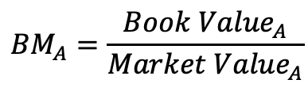
Semi-Strong Form Anomalies (Part 2)
BOOK-TO-MAKRET EFFECTS
Book Value: this is the value of a firm that is reported on the balance sheet (the real assets of the company)
Market Value: market cap * shares outstanding
Book-to-Market (BM) says that companies with high BM Ratio should outperform companies with low ratios
Originally argued that +BM required the investor to take on more risk and thus have higher expected returns (Fama & French 1992)
This may not be the case because firms with high risk of credit defaults have shown high levels of reversion (Mohanram 2004)
Important to analyze the BM Effect in the context of the company/industry
e.g. R&D companies focus on R&D fundamentals
This has shown to have significant effects on gaining outsized returns
Have to be careful for conservative accounting in reserve accounts because of accounting conservatism (Penman & Zhang 2002)
$${BM}_{A}=\frac{{Book Value}_{A}}{{Market Value}_{A}}$$

Slide 21
Introduction to Factors
ONE CAN USE FACTOR MODELS TO GAIN ”MORE” INFORMATION ABOUT THE MARKET
Above we have looked at a variety of indicators that could/have been used to predict outsized expected return by traders
For example, liquidity risk could be used in a trading strategy to know when to exist the market or a particular stock
We could also use CAPM as a factor to predict expected returns
Over the next meetings we are going to go over various factors and factor models that have been proposed over the years
Using a factor model is an intuitive way to predict expected returns using a factor model we are going to find how well certain factors map to the market
Then calculate these factors at intervaled periods and come up with predictions of price movements

Slide 22
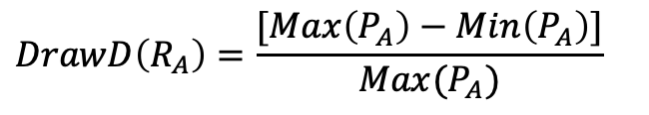
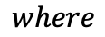
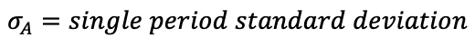
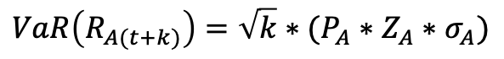
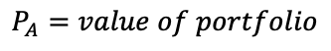
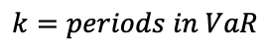
Additional Measures of Risk
WE CONTINUE TO BE INTERESTED IN ADJUSTED-RISK RETURNS NOT JUST EXPECTED RETURNS
In the beginning of this presentation we discussed how just expected returns did not matter but the risk of an investment did as well
This is because investors would simply just choose the riskiest asset if they only cared about returns
So far we can thinking about risk-adjusted returns in two three ways: variance, Sharpe Ratio, and Sortino Ratio
There are a wide variety of ways to look at risk of a security, to look at a few more:
Value-at-Risk (VaR): the value of a portfolio at risk of loss in the event of near BSEs
Draw-Down: find the percentage difference between the maximum and minimum price/value of a portfolio or stock within a period
Time-Under-Water: derived from Draw Down where you calculate the number of days been the max and min (Lopez de Parado 2011)
$$VaR\left(R_{A(t+k)}\right)=\sqrt{k}∗(P_{A}∗Z_{A}∗σ_{A})$$
$$where$$
$$k=periods in VaR$$
$$P_{A}=value of portfolio$$
$$Z_{A}=zscore of confidence interval \sim N\left(0,1\right)$$
$$σ_{A}=single period standard deviation$$
$$DrawD\left(R_{A}\right)=\frac{[Max\left(P_{A}\right)−Min\left(P_{A}\right)]}{Max(P_{A})}$$

Slide 23
Frictions in the Market
STANDARD FRICTIONS EXIST WHILE TRADING IN THE MARKET IGNORED IN THEORY
Up to this point the theory that backs these idea has made a large number of unrealistic assumptions about the stock market
No taxes
Can borrow at the risk-free rate
Investors are always rational
From observation, and the statistical variation from expected to realized returns, we know that many theoretical descriptions fail
Besides this we should also note the friction that QMI in our own processes have:
Very imperfect access to information; computing power etc. prevents of from immediately adjusting models
Trading costs; we have to pay a fee for every trade that we make
Time limitations; cannot have perfect assumptions or predictions because of resource limitations
From this what are somethings that we should limit about potential QMI strategies

Slide 24
Our New Market View
HOW THIS SHOULD EFFECT OUR VIEW OF THE MARKET
Most (if not all) of the factors that we reviewed came from backtesting and paper trading on the market
This indicates that, at least in the short term, factors and models can gain outsized returns
Generally, we think of these models as exploiting inefficiencies in the market
Models are able to mathematically find where traders are misjudging the market
Although daily returns of the market are roughly symmetric there are BSEs or similar
Important for us to be able to predict these events and exit the market
Remember the question from interviews
Some models exist to predict this market time
Above we mentioned that models or factors could predict outsized returns for a period
The market will eventually remove the inefficiencies that factors trade on
People are trading every second during trading hours so as enough people find the inefficiency it will be removed
Prices are bid up till capital gains are removed
These were all, at some point, novel ways to view and trade on the market
They probably gained alpha and there might still be some return left
We, current investors, gain consistent risk-adjusted returns from building on these ideas
This is why it is important go over them. Not just to understand the market, but to know what is already out there

Slide 25
Citations
Adrian, Tobias and Franzoni, Francesco A., Learning About Beta: Time-Varying Factor Loadings, Expected Returns, and the Conditional CAPM (October 8, 2008). Federal Reserve Bank of New York Staff Report No. 193, Available at SSRN: https://ssrn.com/abstract=391562 or http://dx.doi.org/10.2139/ssrn.391562
Manhire, Jack, Measuring Black Swans in Financial Markets (February 28, 2018). 8 Journal of Mathematical Finance 227 (2018), Available at SSRN: https://ssrn.com/abstract=3085747
Benhamou, Eric and Ohana, Jean-Jacques and Saltiel, David and Guez, Beatrice, Planning in Financial Markets in Presence of Spikes: Using Machine Learning GBDT (June 8, 2021). Available at SSRN: https://ssrn.com/abstract=3862428 or http://dx.doi.org/10.2139/ssrn.3862428
Crain, Michael A., A Literature Review of the Size Effect (October 29, 2011). Available at SSRN: https://ssrn.com/abstract=1710076 or http://dx.doi.org/10.2139/ssrn.1710076
Christoffersen, Peter and Feunou, Bruno and Jeon, Yoontae and Ornthanalai, Chayawat, Time-Varying Crash Risk Embedded in Index Options: The Role of Stock Market Liquidity (July 20, 2018). Rotman School of Management Working Paper No. 2797308, Available at SSRN: https://ssrn.com/abstract=2797308 or http://dx.doi.org/10.2139/ssrn.2797308
Mohanram, Partha S., Separating Winners from Losers Among Low Book-to-Market Stocks Using Financial Statement Analysis (April 2004). Available at SSRN: https://ssrn.com/abstract=403180 or http://dx.doi.org/10.2139/ssrn.403180
López de Prado, Marcos and López de Prado, Marcos and Peijan, Achim, Measuring Loss Potential of Hedge Fund Strategies. Available at SSRN: https://ssrn.com/abstract=641702

